Slide 1



UNIVERSITY INSTITUTE OF ENGINEERING
COMPUTER SCIENCE
& ENGINEERING
Bachelor of Engineering
Robotics Process Automation(20CST-472)
Prepared By: Ms Jyoti Chandel(E15580)
Topic: Automation Anywhere, Blue Prism
DISCOVER . LEARN . EMPOWER

Slide 2
Blue Prism
Blue Prism is an RPA Tool that provides a virtual workforce to the organizations. It helps organizations to automate manual, repetitive, and rule-based business processes in an agile and cost-effective manner. It includes drag and drop support to automate the tasks.

Slide 3
Features
It is platform-independent so that it can be used on any platform.
It contains robust features like load balancing, data encryption, and end-to-end auditing. Thus, every change is audited.
Blue Prism also supports automation of codes written in Mainframe, Java, Windows applications, and even web-based applications.
It supports all major cloud platforms, like Microsoft Azure and Amazon AWS. So, users can manage most of the tasks centrally.

Slide 4
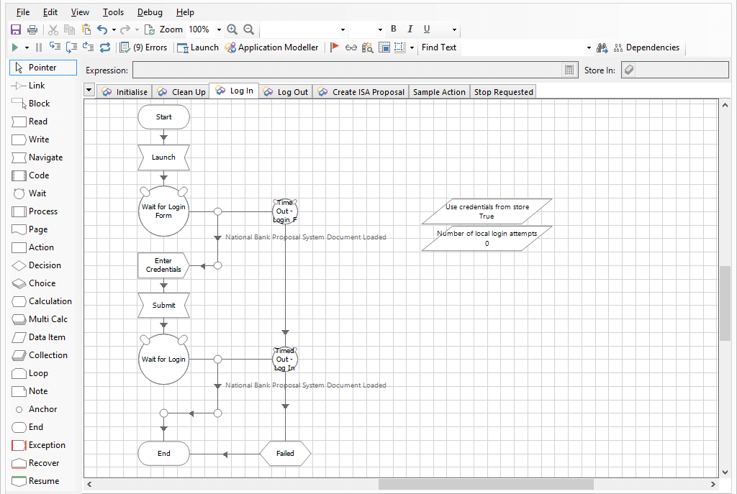
Blue Prism

Slide 5
Automation Anywhere
Automation Anywhere is one of the popular RPA vendors that offers powerful and user-friendly capabilities to automate any complex business process. This tool is a combination of all the core functions. It combines RPA with intellectual elements like language understanding and reading any unstructured data.
Automation Anywhere is a web-based administration system that provides control to run and manage end-to-end automated business tasks for companies. It allows automating a broad range of tasks, from basic windows configuration steps to the ultimate networking and remote database processes.

Slide 6
Automation Anywhere Features
It provides easy integration with different platforms.
It provides Bank-grade security through authentication, encryption, and credentials.
It distributes tasks to multiple computers and rapidly automates complex and complicated tasks.
It offers scriptless automation

Slide 7
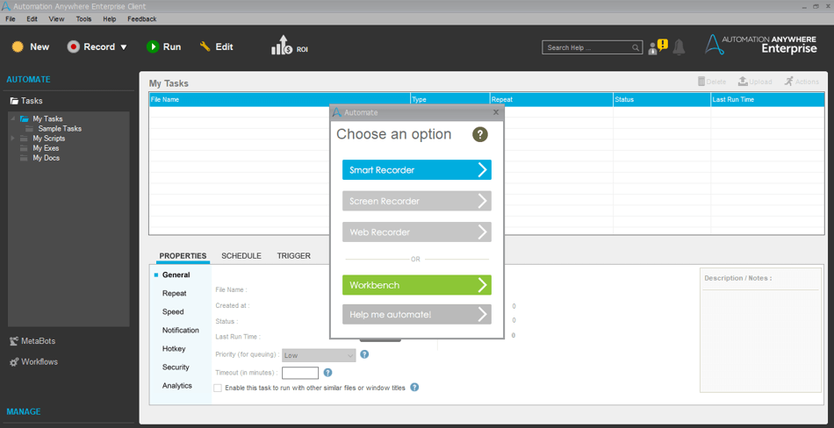
Automation Anywhere

Slide 8
UiPath vs Automation Anywhere
1. AUTOMATION PLATFORM:
UiPath requires third-party integration to deliver similar solutions like Automation Anywhere thus increasing support and installation complexity. Whereas Automation Anywhere comes with an all-inclusive and automated platform and can be used instantly.
2. MODERN ARCHITECTURE:
UiPath is based on ‘web-based orchestrator’ architecture that helps to connect automated tasks into an integrated workflow and is set to achieve specific goals with permissions policy enforcement. Automation Anywhere is based on ‘client-server architecture’ where every node or system is either a client or a server.
3. EASY TO USE:
UiPath requires more intervention by the IT and development team as it is targeted towards the developer community. But Automation Anywhere’s easy-to-use platform allows the users to develop their kind of automation.

Slide 9
UiPath vs Automation Anywhere
4. SECURITY:
UiPath consists of incomplete security certifications and standards lacking SOC 1 Type 2, SOC 2 Type 2, and ISO 22301 that create business and compliance risks. To enhance the security standards offered by UiPath the user has to bear the extra costs. Whereas Automation Anywhere offers such security standards that are best in class including SOC 1 Type 2, SOC 2 Type 1 and Type 2, ISO 27001, FISMA Security controls, etc. that keep the platform secure and compliant.
5. EASIER TO SCALE:
UiPath’s architecture is unable to scale and requires duplicate copies of the entire application for every expansion of functionality. Automation Anywhere can instantly scale to several bots in the front and back office.

Slide 10
Uipath vs BluePrism
1. MODERN ARCHITECTURE:
As discussed earlier RPA UiPath is based on the ‘web-based orchestrator’ architecture where automated tasks are connected to a unified workflow set to achieve specific goals with permissions policy enforcement. On the other hand, BluePrism is based on ‘client-server architecture’ like Automation Anywhere where every computer acts as a client as well as server.
2. EASY TO USE:
UiPath can be accessed from mobile as well as web browsers whereas BluePrism can only be accessed through apps designed to do so.
3. SECURITY:
UiPath comes with incomplete security standards and certifications that create business and compliance risks and to enhance the security features the user has to put in extra efforts and bear the costs. However, BluePrism offers complete security features for the enterprise level. The encryption feature ensures data protection and also offers easy additional encryption features.

Slide 11
UiPath vs BluePrism vs Automation Anywhere.
FEATURES | UIPATH | BLUEPRISM | AUTOMATION ANYWHERE
1. LEARNING | Based on visual design this tool provides faster implementation | Can create and manage business objects in the control center. Basic programming skills are required. | An easy to use tool for freshers and basic developers
2. ARCHITECTURE | Based on ‘web-based orchestrator’ architecture | Based on ‘client-server architecture’ | Based on ‘client-server architecture’
3. APPLICATION OR USE | Used for BPO automation as well as Citrix automation | Used for web, desktop, and Citrix automation | Can be used efficiently on all mediums

Slide 12
UiPath vs BluePrism vs Automation Anywhere.
4. SOFTWARE BOTS | Used for both front-office and back-office automation | Can only be used for back-office automation | Used for both front and back-office automation
5. TECHNOLOGY | Based on several technologies like Sharepoint, Cabana, and elastic search | Based on C# (C sharp) | Based on Microsoft technologies
6. PROGRAMMING SKILLS | Programming skills are not compulsory | Since it is based on C#, programming skills are required. However, users can use it without coding skills | Programming knowledge is not necessary.

Slide 13
UiPath vs BluePrism vs Automation Anywhere
7. RELIABILITY | Can be moderately relied upon | Offers high reliability | One of the most important features of this tool is high reliability.
8. OPERATIONAL SCALABILITY | Often crashes while working on medium projects | Has good operational scalability with high execution speed | Offers limited deployment in large scale robot integration

Slide 14
References
Websites:
https://www.javatpoint.com/rpa-tools
https://www.zenesys.com/uipath-vs-automation-anywhere-vs-blueprism#:~:text=BluePrism%20is%20developer-centric%20with%20complex%20UI%20limits%20adoption.,a%20single%20web-based%20solution%20with%20a%20budget-friendly%20approach.

Slide 15
THANK YOU

